Slide 1
Chapter 13: Patterns and Tactics
Pingjian Zhang
School of Software Engineering, SCUT
2018

Slide 2
Chapter Outline
What is a Pattern?
Pattern Catalogue
Module patterns
Component and Connector Patterns
Allocation Patterns
Relation Between Tactics and Patterns
Using tactics together
Summary

Slide 3
各种风格
建筑风格
文学、艺术风格
行事风格
Notes:
特征鲜明

Slide 4
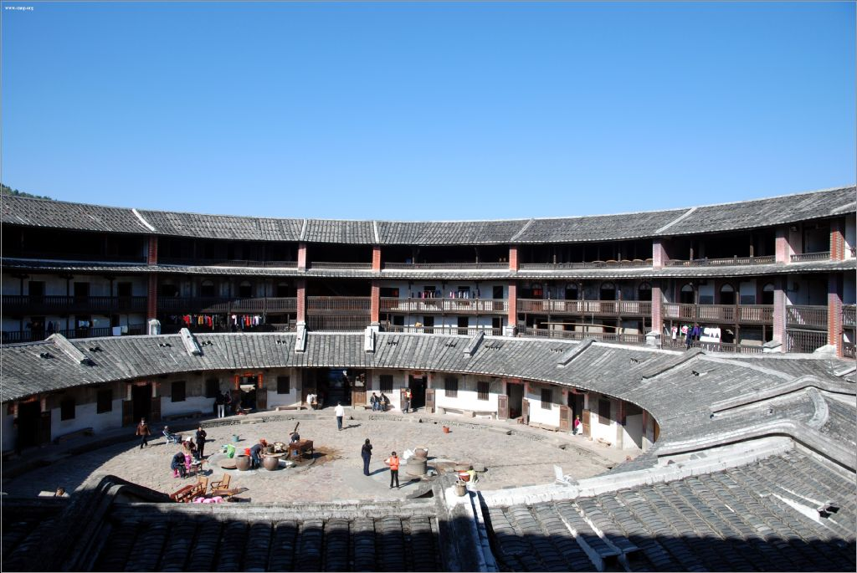

Slide 5
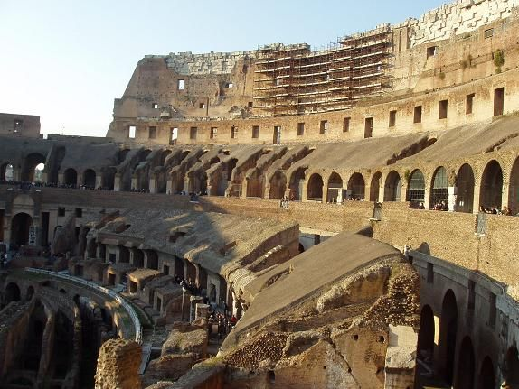

Slide 6


Slide 7


Slide 8
What is a Pattern?
An architectural pattern establishes a relationship between:
A context. A recurring situation giving rise to a problem.
A problem
A solution. A successful architectural resolution to the problem, appropriately abstracted, determined and described by:
A set of element types
A set of interaction mechanisms or connectors
A topological layout of the components
A set of semantic constraints covering topology, element behavior, and interaction mechanisms

Slide 9
Pattern Catalogue
Module patterns
Layer Pattern
OOP Pattern
Component and Connector Patterns
Broker Pattern
MVC Pattern
Pipe and Filter Pattern
Client-Server Pattern
Peer-to-Peer Pattern
SOA Pattern
Publish-Subscribe Pattern
Shared-Data Pattern

Slide 10
Pattern Catalogue
Allocation Patterns
Map-Reduce Pattern
Multi-Tier Pattern
Patterns are mainly determined by connectors

Slide 11
Layer Pattern
Context: Separation of concerns.
Problem: The software needs to be segmented in such a way that the modules can be developed and evolved separately with little interaction among the parts, supporting portability, modifiability, and reuse.
Solution: Divides the software into units called layers. Each layer is a grouping of modules that offers a cohesive set of services. The usage must be unidirectional.

Slide 12
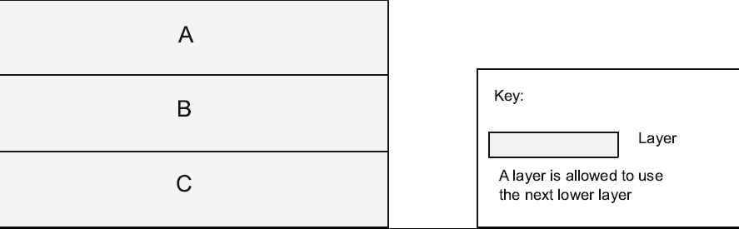
Layer Pattern Example
Notes:
竖立的层贯穿所有的层

Slide 13
Layer Pattern Solution
Overview: The layered pattern defines layers and a use relation.
Elements: Layer.
Relations: Allowed to use.
Constraints:
Every piece of software is allocated to exactly one layer.
There are at least two layers (but usually there are three or more).
The allowed-to-use relations should not be circular (i.e., a lower layer cannot use a layer above).
Weaknesses:
The addition of layers adds up-front cost and complexity to a system.
Layers contribute a performance penalty.
Notes:
Weaknesses：组织机构政令不通

Slide 14
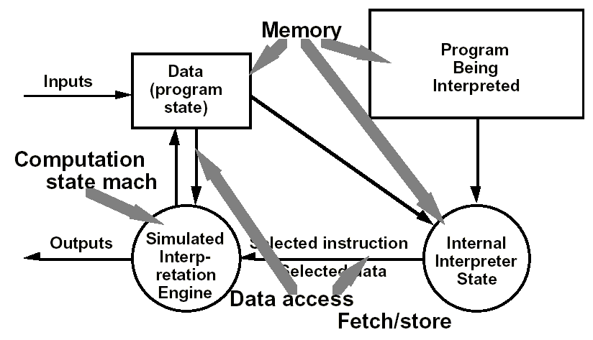
Example: Interpreter
Notes:
Architecture is based on a virtual machine produced in software.
Special kind of a layered architecture where a layer is implemented as a true language interpreter.
Components are ‘program’ being executed, its data, the interpretation engine and its state.

Slide 15
Applications of Interpreter 解释器的用途
Languages 解释型语言
VB、Javascript、VBScript、HTML、CSS、Java、C#、SQL、Matlab
Scripts 脚本、配置文件
Communication protocols 通信协议
Expert systems, Rule-base systems
Text processing 文本处理
User input 用户输入
Keyboard composition in games 游戏中的组合按键
Notes:
JVM, .NET

Slide 16
Broker Pattern
Context: distributed services interoperate with each other.
Problem: How do we structure distributed software so that service users do not need to know the nature and location of service providers, making it easy to dynamically change the bindings between users and providers?
Solution: The broker pattern separates users of services (clients) from providers of services (servers) by inserting an intermediary, called a broker.
Notes:
背景：找服务：小村子到大都市。中介商、代理商：房产中介、非诚勿扰

Slide 17
Broker Example

Slide 18
Broker Solution I
Overview: The broker mediates the communication between a number of clients and servers.
Elements:
Client, a requester of services
Server, a provider of services
Broker, an intermediary
Client-side proxy, a helper intermediary that manages the actual communication with the broker
Server-side proxy, a helper intermediary that manages the actual communication with the broker

Slide 19
Broker Solution II
Relations: The attachment relation associates clients and servers with brokers.
Constraints: The client can only attach to a broker. The server can only attach to a broker.
Weaknesses:
Brokers add a layer of indirection, may be a communication bottleneck.
The broker can be a single point of failure.
A broker adds up-front complexity.
A broker may be a target for security attacks.
A broker may be difficult to test.
Notes:
Constraints: 房产中介官司
difficult to test：分布式

Slide 20
Example
Corba
WebSphere Message Broker
DataGuard
Notes:
甲骨文推出的一种高可用性数据库方案

Slide 21
Model-View-Controller Pattern
Context: separate view from model.
Problem: How can user interface functionality be kept separate from application functionality and yet still be responsive to user input, or to changes in the underlying application’s data? And how can multiple views of the user interface be created, maintained, and coordinated when the underlying application data changes?
Solution: The model-view-controller (MVC) pattern separates application functionality into three kinds of components.

Slide 22
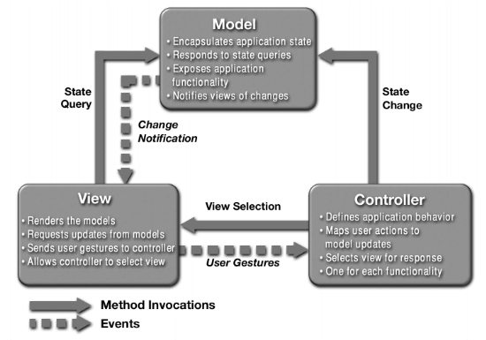
MVC Example

Slide 23
MVC Solution I
Overview: The MVC pattern breaks system functionality into a model, a view, and a controller that mediates between the model and the view.
Elements:
The model.
The view.
The controller.

Slide 24
MVC Solution II
Relations: The notifies relation connects instances of model, view, and controller, notifying elements of relevant state changes.
Constraints:
The model component should not interact directly with the view.
Weaknesses:
The complexity may not be worth it for simple user interfaces.
The model, view, and controller abstractions may not be good fits for some user interface toolkits.
Notes:
Notifies：观察者模式、事件风格
not be good fits for some user interface toolkits：调色板

Slide 25
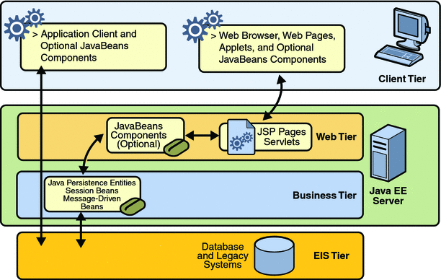
Example: The Java EE Model

Slide 26
Pipe and Filter Pattern
Context: process data streams.
Problem: Such systems need to be divided into reusable, loosely coupled components with simple, generic interaction mechanisms.
Solution: The pattern of interaction in the pipe-and-filter pattern is characterized by successive transformations of streams of data.
Notes:
Ford、日本汽车工业、美国工会

Slide 27
Pipe and Filter Solution
Overview: Data is transformed by filters connected by pipes.
Elements:
Filter.
Pipe.
Relations: The attachment relation associates the output of filters with the input of pipes and vice versa.
Constraints:
Pipes connect filter output ports to filter input ports.
Connected filters must agree on the type of data being passed along the connecting pipe.

Slide 28
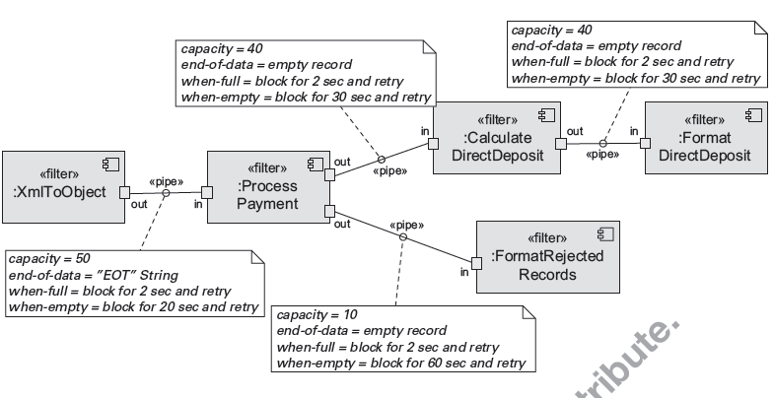
Pipe and Filter Example
Notes:
direct deposit：是一种工资直接进入帐户的付薪方法
ETL

Slide 29
Client-Server Pattern
Context: There are shared resources and services that large numbers of distributed clients wish to access.
Problem: We want to improve scalability and availability by centralizing the control of these resources and services, while distributing the resources themselves across multiple physical servers.
Solution: Clients interact by requesting services of servers, which provide a set of services.
Notes:
1980’s 资源珍贵
特定环境提供安全性、性能

Slide 30
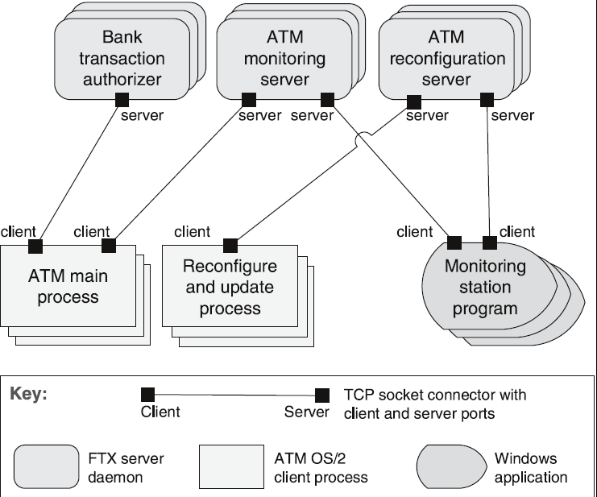
Client-Server Example

Slide 31
Client-Server Solution I
Overview: Clients initiate interactions with servers, invoking services as needed from those servers and waiting for the results of those requests.
Elements:
Client.
Server.
Request/reply connector: a data connector employing a request/reply protocol, used by a client to invoke services on a server.

Slide 32
Client-Server Solution II
Relations: The attachment relation associates clients with servers.
Constraints:
Clients are connected to servers through request/reply connectors.
Weaknesses:
Server can be a performance bottleneck.
Server can be a single point of failure.
Decisions about where to locate functionality are often complex and costly to change after a system has been built.

Slide 33
Peer-to-Peer Pattern
Context: Distributed computational entities are considered equal.
Problem: How can a set of “equal” distributed computational entities be connected to each other via a common protocol so that they can organize and share their services with high availability and scalability?
Solution: In the peer-to-peer (P2P) pattern, components directly interact as peers. All peers are “equal” and no peer or group of peers can be critical for the health of the system.
Notes:
互联网初衷：DoD指挥中心
互联网资源单向服务→共享

Slide 34
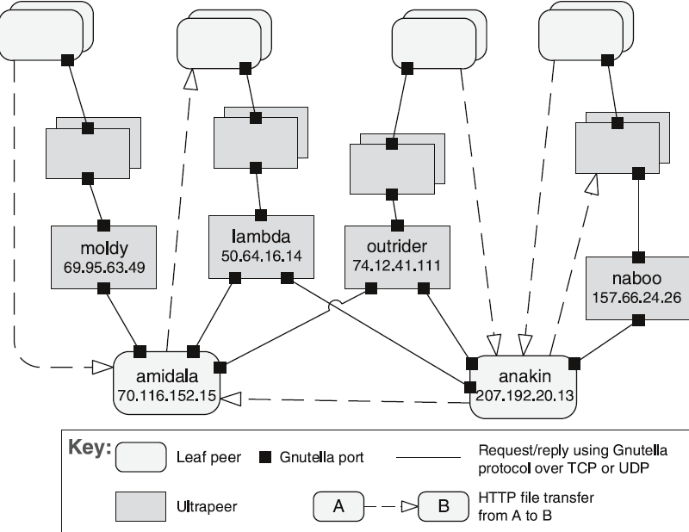
Peer-to-Peer Example

Slide 35
Peer-to-Peer Solution I
Overview: Computation is achieved by cooperating peers.
Elements:
Peer.
Request/reply connector.
Relations: The relation associates peers with their connectors. Attachments may change at runtime.

Slide 36
Peer-to-Peer Solution II
Constraints: Restrictions may be placed on the following:
The number of allowable attachments to any given peer
The number of hops used for searching for a peer
Which peers know about which other peers
Some P2P networks are organized with star topologies, in which peers only connect to supernodes.
Weaknesses:
Managing security, data consistency, data/service availability, backup, and recovery are all more complex.
Small peer-to-peer systems may not be able to consistently achieve quality goals such as performance and availability.

Slide 37
Service Oriented Architecture Pattern
Context: A number of services interoperates without any detailed knowledge of their implementation.
Problem: How can we support interoperability of distributed components running on different platforms and written in different implementation languages, provided by different organizations, and distributed across the Internet?
Solution: The service-oriented architecture (SOA) pattern describes a collection of distributed components that provide and/or consume services.
Notes:
背景：业务对齐、服务交互，中立

Slide 38
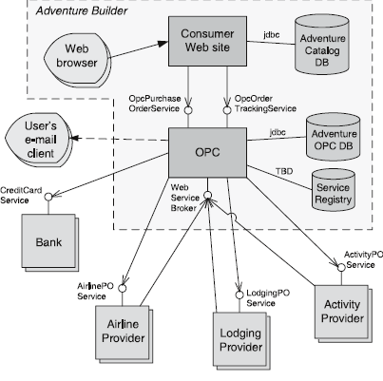
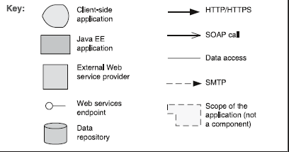
Service Oriented Architecture Example
Notes:
自助游：Order Processing Center

Slide 39
Service Oriented Architecture Solution I
Overview: Computation is achieved by a set of cooperating services over a network.
Elements:
Components:
Service providers.
Service consumers.
ESB, an intermediary element that can route and transform messages between service providers and consumers.
Registry of services.
Orchestration server, which coordinates the interactions between service consumers and providers based on languages for business processes and workflows.

Slide 40
Service Oriented Architecture Solution II
Connectors:
SOAP connector, which uses the SOAP protocol for synchronous communication between web services, typically over HTTP.
REST connector, which relies on the basic request/reply operations of the HTTP protocol.
Asynchronous messaging connector, which uses a messaging system to offer point-to-point or publish-subscribe asynchronous message exchanges.

Slide 41
Service Oriented Architecture Solution III
Relations: Attachment of the different kinds of components available to the respective connectors
Constraints: Service consumers are connected to service providers.
Weaknesses:
SOA-based systems are typically complex to build.
There is a performance overhead associated with the middleware, and services may be performance bottlenecks, and typically do not provide performance guarantees.

Slide 42
Publish-Subscribe Pattern
Context: The precise number and nature of the data producers and consumers are not predetermined or fixed, nor is the data that they share.
Problem: How can we create integration mechanisms that support the ability to transmit messages among the producers and consumers so they are unaware of each other’s identity, or potentially even their existence?
Solution: In the publish-subscribe pattern, components interact via announced messages, or events.
Notes:
通常跟观察者模式、事件风格相联系

Slide 43
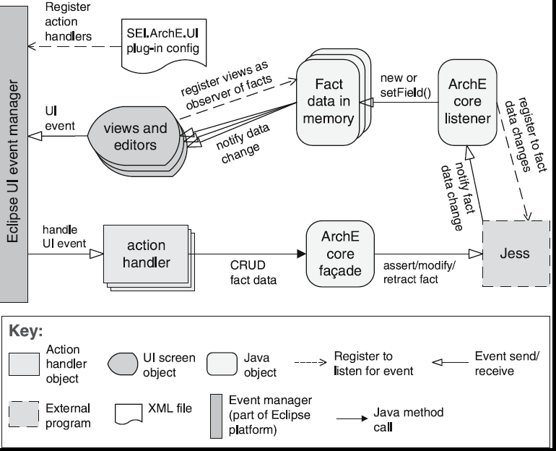
Publish-Subscribe Example
Notes:
GUI、MVC、ERP、IDE、Mailing list

Slide 44
Publish-Subscribe Solution I
Overview: Components publish and subscribe to events. When an event is announced by a component, the connector infrastructure dispatches the event to all registered subscribers.
Elements:
Publisher, subscriber.
The publish-subscribe connector.
Relations: The attachment relation associates components with the publish-subscribe connector by prescribing which components announce events and which components are registered to receive events.

Slide 45
Publish-Subscribe Solution II
Constraints: Publish ports are attached to announce roles and subscribe ports are attached to listen roles.
Weaknesses:
Typically increases latency and has a negative effect on scalability and predictability of message delivery time.
Less control over ordering of messages, and delivery of messages is not guaranteed.

Slide 46
Shared-Data Pattern
Context: Various computational components need to share and manipulate large amounts of data.
Problem: How can systems store and manipulate persistent data that is accessed by multiple independent components?
Solution: In the shared-data pattern, interaction is dominated by the exchange of persistent data between multiple data accessors and at least one shared-data store.
Notes:
问题：acid

Slide 47
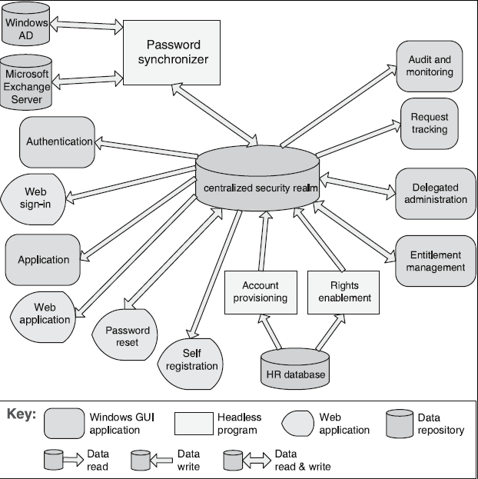
Shared Data Example

Slide 48
Shared Data Solution I
Overview: Communication between data accessors is mediated by a shared data store.
Elements:
Shared-data store.
Data accessor component.
Data reading and writing connector.

Slide 49
Shared Data Solution II
Relations: Attachment relation determines which data accessors are connected to which data stores.
Constraints: Data accessors interact only with the data store(s).
Weaknesses:
The shared-data store may be a performance bottleneck.
The shared-data store may be a single point of failure.
Producers and consumers of data may be tightly coupled.

Slide 50
Map-Reduce Pattern
Context: Need to quickly analyze enormous volumes of data.
Problem: To efficiently perform a distributed and parallel sort of a large data set and provide a simple means for the programmer to specify the analysis to be done.
Solution: The map-reduce pattern requires three parts:
A specialized infrastructure takes care of allocating the data as needed.
A map which filters the data to retrieve items.
A reduce which combines the results of the map.

Slide 51
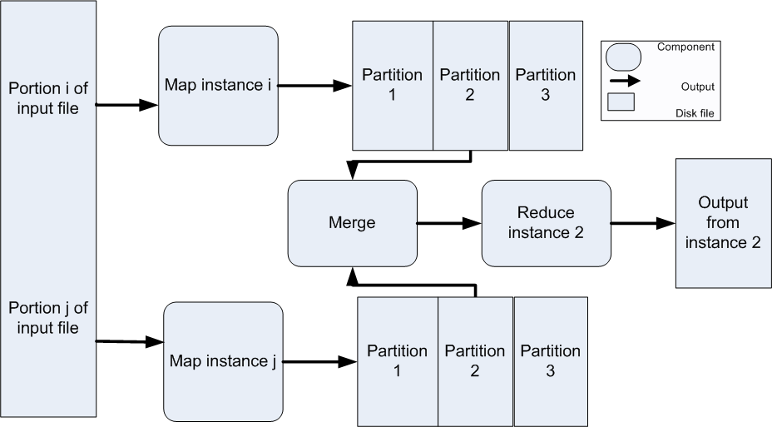
Map-Reduce Example

Slide 52
Map-Reduce Solution I
Overview: The map-reduce pattern provides a framework for analyzing a large distributed set of data. The map performs the extract and transform portions of the analysis and the reduce performs the loading of the results.
Elements:
Map.
Reduce.
The infrastructure is the framework responsible for deploying map and reduce instances, shepherding the data between them, and detecting and recovering from failure.

Slide 53
Map-Reduce Solution II
Relations:
Deploy on.
Instantiate, monitor, and control is the relation between the infrastructure and the instances of map and reduce.
Constraints:
The data to be analyzed must exist as a set of files.
Map functions are stateless and do not communicate with each other.
Weaknesses:
Overhead.
If you cannot divide your data set into similar sized subsets, the advantages of parallelism are lost.
Operations that require multiple reduces are complex to orchestrate.

Slide 54
Multi-Tier Pattern
Context: To distribute a system’s infrastructure into distinct subsets.
Problem: How can we split the system into a number of computationally independent execution structures—groups of software and hardware—connected by some communications media?
Solution: The execution structures of many systems are organized as a set of logical groupings of components. Each grouping is termed a tier.

Slide 55
Multi-Tier Example

Slide 56
Multi-Tier Solution
Overview: The execution structures of systems are organized as a set of logical groupings of components.
Elements:
Tier.
Relations:
Is part of.
Communicates with.
Allocated to.
Constraints: A software component belongs to exactly one tier.
Weaknesses: Substantial up-front cost and complexity.

Slide 57
Relationships Between Tactics and Patterns
Patterns are built from tactics; if a pattern is a molecule, a tactic is an atom.
MVC, for example utilizes the tactics:
Increase semantic coherence
Encapsulation
Use an intermediary
Use run time binding

Slide 58
Tactics Augment Patterns
Patterns solve a specific problem but are neutral or have weaknesses with respect to other qualities.
Consider the broker pattern
May have performance bottlenecks
May have a single point of failure
Using tactics such as
Increase resources will help performance
Maintain multiple copies will help availability

Slide 59
Tactics and Interactions - 1
Each tactic has pluses (its reason for being) and minuses – side effects.
Use of tactics can help alleviate the minuses.
But nothing is free…

Slide 60
Tactics and Interactions - 2
A common tactic for detecting faults is Ping/Echo.
Common side-effects of Ping/Echo are:
security: how to prevent a ping flood attack?
performance: how to ensure that the performance overhead of ping/echo is small?
modifiability: how to add ping/echo to the existing architecture?
Notes:
Tactic is fine grain adjustment of quality attributes within a pattern

Slide 61
Tactics and Interactions - 3
System
Ping/Echo
Add to
system
Ping
flood
Performance
overhead

Slide 62
Tactics and Interactions - 4
A tactic to address the performance side-effect is “Increase Available Resources”.
Common side effects of Increase Available Resources are:
cost: increased resources cost more
performance: how to utilize the increase resources efficiently?

Slide 63
Tactics and Interactions - 5
System
Ping/Echo
Add to
system
Ping
flood
Performance
overhead
Increase Available
Resources
Cost
Resource
Utilization

Slide 64
Tactics and Interactions - 6
A tactic to address the efficient use of resources side-effect is “Scheduling Policy”.
Common side effects of Scheduling Policy are:
modifiability: how to add the scheduling policy to the existing architecture
modifiability: how to change the scheduling policy in the future?

Slide 65
Tactics and Interactions - 7
System
Ping/Echo
Add to
system
Ping
flood
Performance
overhead
Increase Available
Resources
Cost
Resource
Utilization
Scheduling
Policy
Add to
system
Modify
policy

Slide 66
Tactics and Interactions - 8
A tactic to address the addition of the scheduler to the system is “Use an Intermediary”.
Common side effects of Use an Intermediary are:
modifiability: how to ensure that all communication passes through the intermediary?

Slide 67
Tactics and Interactions - 9
System
Ping/Echo
Add to
system
Ping
flood
Performance
overhead
Increase Available
Resources
Cost
Resource
Utilization
Scheduling
Policy
Add to
system
Modify
policy
Use an
Intermediary
Ensure
usage

Slide 68
Tactics and Interactions – 10.
A tactic to address the concern that all communication passes through the intermediary is “Restrict Communication Paths”.
Common side effects of Restrict Communication Paths are:
performance: how to ensure that the performance overhead of the intermediary are not excessive?
Note: this design problem has now become recursive!

Slide 69
How Does This Process End?
Each use of tactic introduces new concerns.
Each new concern causes new tactics to be added.
Are we in an infinite progression?
No. Eventually the side-effects of each tactic become small enough to ignore.

Slide 70
Summary
An architectural pattern
is a package of design decisions that is found repeatedly in practice,
has known properties that permit reuse, and
describes a class of architectures.
Tactics are simpler than patterns
Patterns are underspecified with respect to real systems so they have to be augmented with tactics.
Augmentation ends when requirements for a specific system are satisfied.

